Slide 1

CHAPTER 12
REGULAR
EXPRESSIONS
AND FINITE-STATE
AUTOMATA
Copyright © Cengage Learning. All rights reserved.

Slide 2
SECTION 12.3
Simplifying Finite-State Automata
Copyright © Cengage Learning. All rights reserved.

Slide 3
Simplifying Finite-State Automata
Any string input to a finite-state automaton either sends the automaton to an accepting state or not, and the set of all strings accepted by an automaton is the language accepted by the automaton.
It often happens that when an automaton is created to do a certain job (as in compiler construction, for example), the automaton that emerges “naturally” from the development process is unnecessarily complicated; that is, there may be an automaton with fewer states that accepts exactly the same language.

Slide 4
Simplifying Finite-State Automata
It is desirable to find such an automaton because the memory space required to store an automaton with n states is approximately proportional to n².
Thus approximately 10,000 memory spaces are required to store an automaton with 100 states, whereas only about 100 memory spaces are needed to store an automaton with 10 states.

Slide 5
Simplifying Finite-State Automata
In addition, the fewer states an automaton has, the easier it is to write a computer algorithm based on it; and to see that two automata both accept the same language, it is easiest to simplify each to a minimal number of states and compare the simplified automata.
In this section we show how to take a given automaton and simplify it in the sense of finding an automaton with fewer states that accepts the same language.

Slide 6
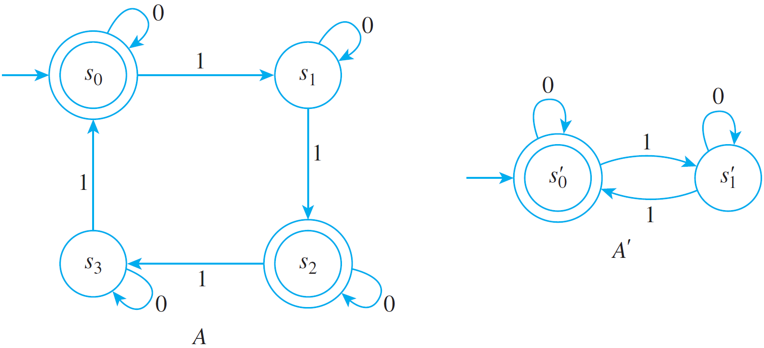
Example 1 – An Overview
Consider the finite-state automata A and A′ in Figure 12.3.1.
Two Equivalent Automata
Figure 12.3.1

Slide 7
Example 1 – An Overview
cont’d
A moment’s thought should convince you that A′ accepts all those strings, and only those strings, that contain an even number of 1’s.
But A, although it appears more complicated, accepts exactly those strings also.
Thus the two automata are “equivalent” in the sense that they accept the same language, even though A′ has fewer states than A.
Roughly speaking, the reason for the equivalence of these automata is that some of the states of A can be combined without affecting the acceptance or nonacceptance of any input string.

Slide 8

Example 1 – An Overview
cont’d
It turns out that s₂ can be combined with state s₀ and that s₃ can be combined with state s₁.
The automaton with the two combined states {s₀, s₂} and {s₁, s₃} is called the quotient automaton of A and is denoted
.
Its transition diagram is obtained by combining the circles for s₀ and s₂ and for s₁ and s₃ and by replacing any arrow from a state s to a state t by an arrow from the combined state containing s to the combined state containing t.

Slide 9
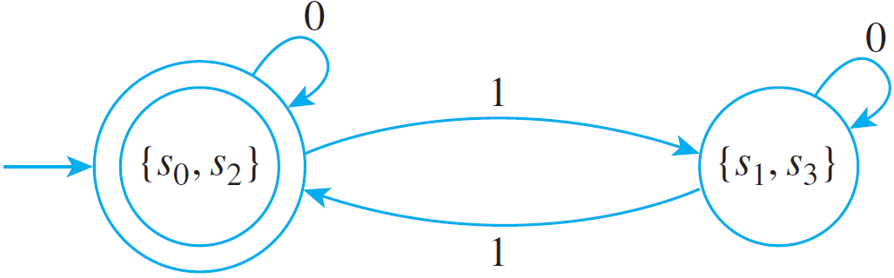
Example 1 – An Overview
cont’d
For instance, since there is an arrow labeled 1 from s₁ to s₂ in A, there is an arrow labeled 1 from {s₁, s₃} to {s₀, s₂} in .
The complete transition diagram for is shown in Figure 12.3.2. As you can see, except for labeling the names of the states, it is identical to the diagram for A′.
Figure 12.3.2

Slide 10
∗-Equivalence of States

Slide 11
∗-Equivalence of States
Two states of a finite-state automaton are said to be
∗-equivalent (this is read “star equivalent”) if any string accepted by the automaton when it starts from one of the states is accepted by the automaton when it starts from the other state.
We know that the value of the eventual-state function, N∗, for a state s and input string w is the state to which the automaton goes if the characters of w are input in sequence when the automaton is in state s.

Slide 12
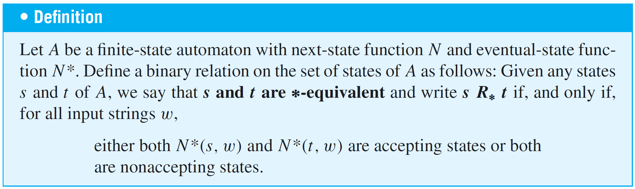
∗-Equivalence of States
In other words, states s and t are ∗-equivalent if, and only if, for all input strings w,

Slide 13
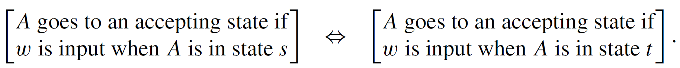
∗-Equivalence of States
Or, more simply, for all input strings w,
It follows immediately, by substitution into the definition, that

Slide 14
k-Equivalence of States

Slide 15
k-Equivalence of States
From a procedural point of view, it is difficult to determine the ∗-equivalence of two states using the definition directly. According to the definition, you must know the action of the automaton starting in states s and t on all input strings in order to tell whether s and t are equivalent.
But since most languages have infinitely many input strings, you cannot check individually the effect of every string that is input to an automaton.
As a practical matter, you can tell whether or not two states s and t are ∗-equivalent by using an iterative procedure based on a simpler kind of equivalence of states called k-equivalence.

Slide 16
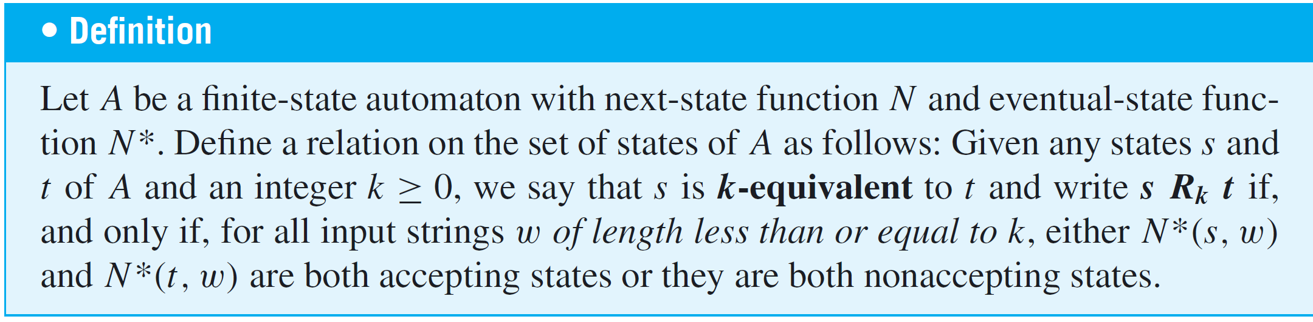
k-Equivalence of States
Two states are k-equivalent if any string of length less than or equal to k that is accepted by the automaton when it starts from one of the states is accepted by the automaton when it starts from the other state.

Slide 17
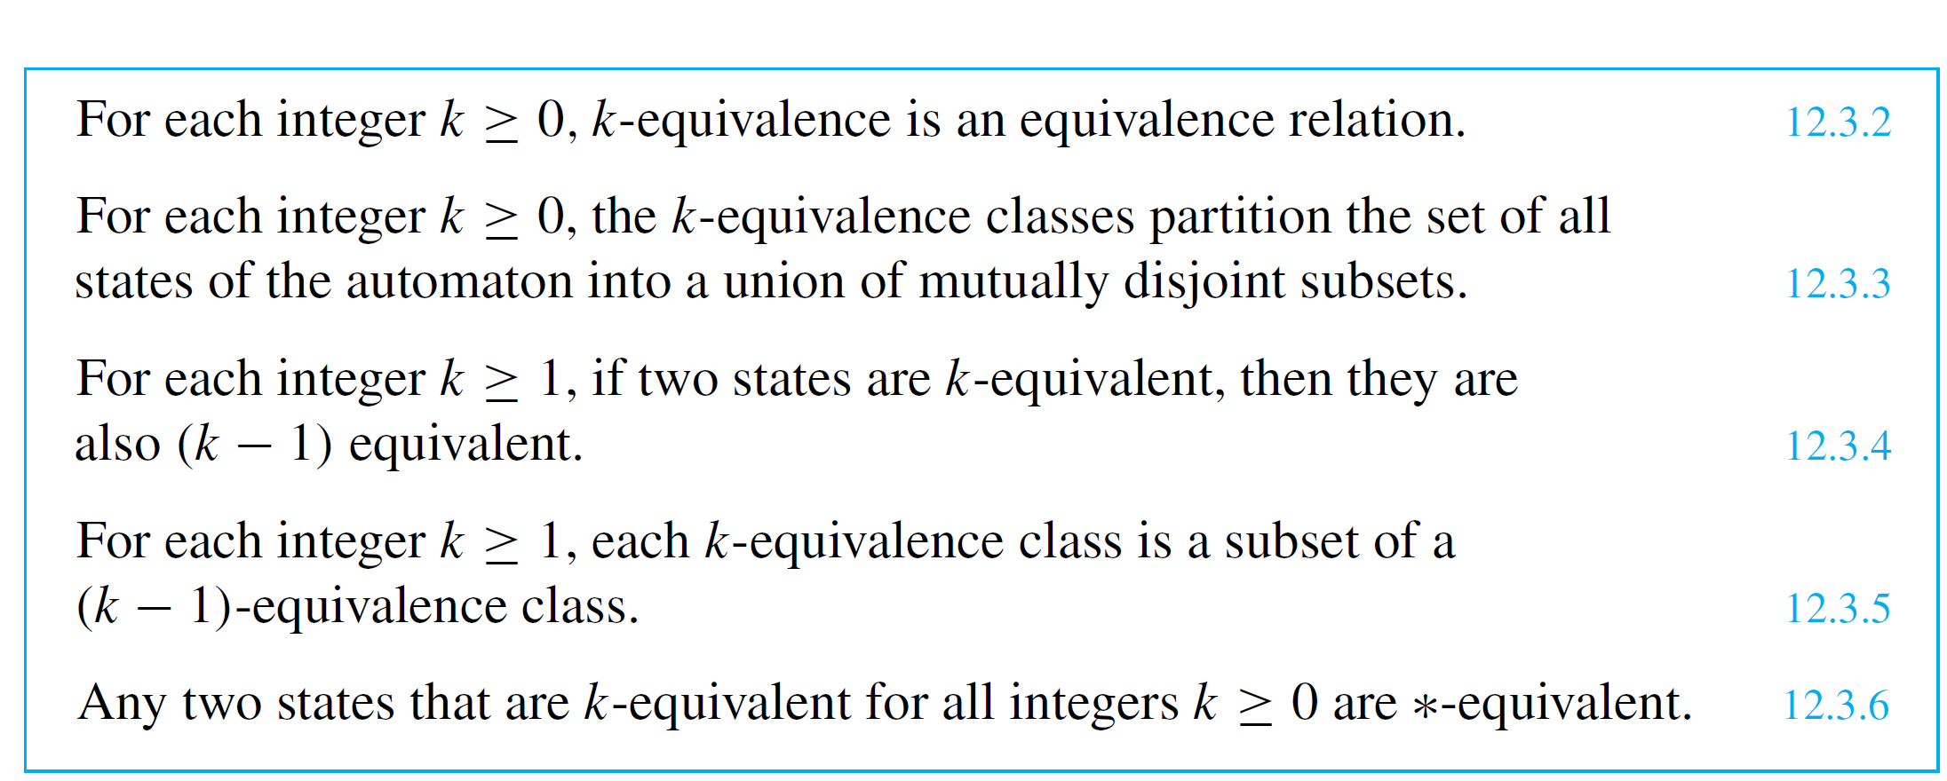
k-Equivalence of States
Certain useful facts follow quickly from the definition of k-equivalence:
The next theorem gives a recursive description of k-equivalence of states.

Slide 18
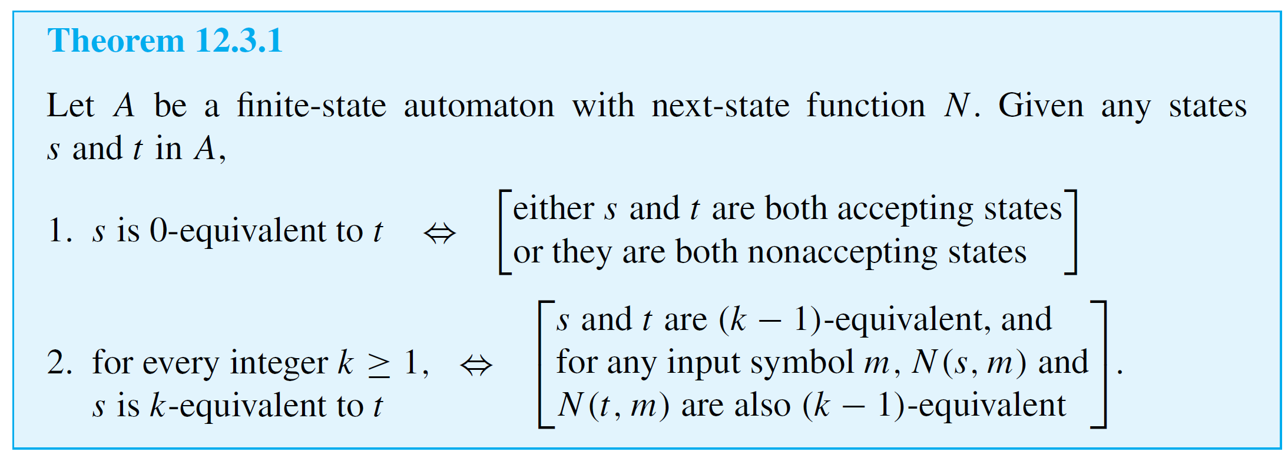
k-Equivalence of States
It says, first, that any two states are 0-equivalent if, and only if, either both are accepting states or both are nonaccepting states and, second, that any two states are k-equivalent (for k ≥ 1) if, and only if, they are (k − 1)-equivalent and for any input symbols their next-states are also (k − 1)-equivalent.

Slide 19
k-Equivalence of States
The truth of Theorem 12.3.1 follows from the fact that inputting a string w of length k has the same effect as inputting the first symbol of w and then the remaining k − 1 symbols of w.
Theorem 12.3.1 implies that if you know which states are (k − 1)-equivalent (where k is a positive integer) and if you know the action of the next-state function, then you can figure out which states are k-equivalent.

Slide 20
k-Equivalence of States
Specifically, if s and t are (k − 1)-equivalent states whose next-states are (k − 1)-equivalent for any input symbol m, then s and t are k-equivalent.
Thus the k-equivalence classes are obtained by subdividing the (k − 1)-equivalence classes according to the action of the next-state function on the members of the classes.

Slide 21
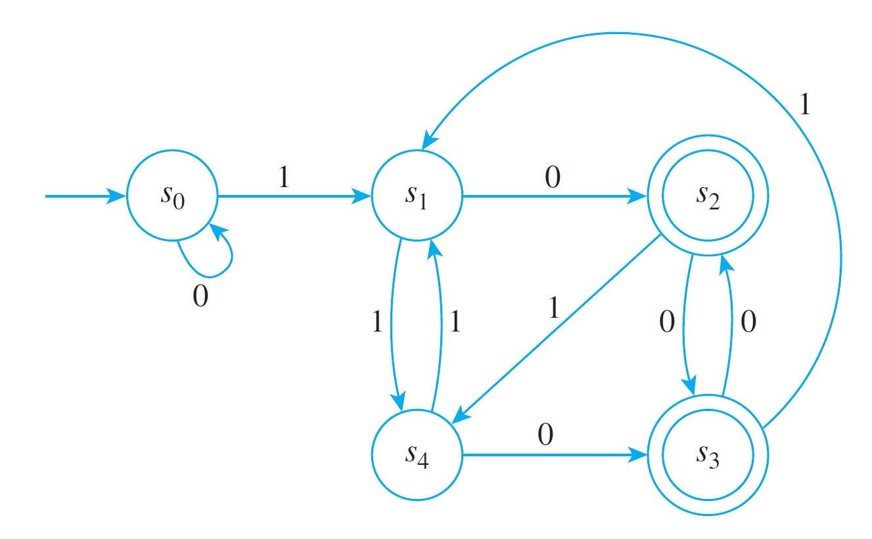
Example 2 – Finding k-Equivalence Classes
Find the 0-equivalence classes, the 1-equivalence classes, and the 2-equivalence classes for the states of the automaton shown below.

Slide 22
Example 2 – Solution
0-equivalence classes: By Theorem 12.3.1 two states
are 0-equivalent if, and only if, both are accepting
states or both are nonaccepting states.
Thus there are two sets of 0-equivalent states:
and so
2. 1-equivalence classes: By Theorem 12.3.1, two
states are 1-equivalent if, and only if, they are
0-equivalent and, after input of any input symbol, their
next-states are 0-equivalent.

Slide 23
Example 2 – Solution
cont’d
  Thus s₁ is not 1-equivalent to s₀ because when a 0 is input to the automaton in state s₁ it goes to state s₂, whereas when a 0 is input to the automaton in state s₀ it goes to state s₀, and s₂ and s₀ are not 0-equivalent.
  On the other hand, s₁ is 1-equivalent to s₄ because when a 0 is input to the automaton in state s₁ or s₄ the next-states are s₂ and s₃, which are 0-equivalent; and when a 1 is input to the automaton in state s₁ or s₄ the next-states are s₄ and s₁, which are 0-equivalent.

Slide 24
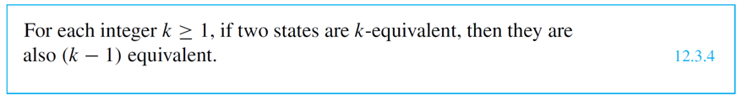
Example 2 – Solution
cont’d
By a similar argument, s₂ is 1-equivalent to s₃. Since
1-equivalent states must also be 0-equivalent
[by property (12.3.4)], no other pairs of states can be
1-equivalent.
Hence
3. 2-equivalence classes: By Theorem 12.3.1, two states are 2-equivalent if, and only if, they are 1-equivalent and, after input of any input symbol, their next-states are 1-equivalent.

Slide 25
Example 2 – Solution
cont’d
Now s₁ is 2-equivalent to s₄ because they are
1-equivalent; and when a 1 is input to the automaton in
state s₁ or s₄ the next-states are s₄ and s₁, which are
1-equivalent; and when a 0 is input to the automaton in
state s₁ or s₄ the next-states are s₂ and s₃, which are
1-equivalent.
Similarly, s₂ is 2-equivalent to s₃. Since 2-equivalent
states must also be 1-equivalent [by property (12.3.4)],
no other pairs of states can be 2-equivalent.

Slide 26
Example 2 – Solution
cont’d
Hence
Note that the set of 2-equivalence classes equals the set
of 1-equivalence classes.

Slide 27
Finding the ∗-Equivalence Classes

Slide 28
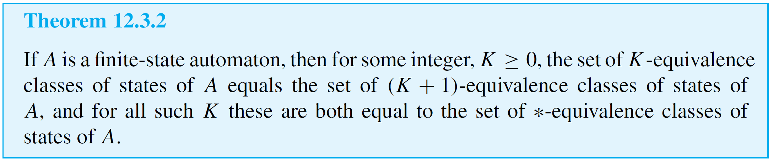
Finding the ∗-Equivalence Classes

Slide 29
Example 3 – Finding ∗-Equivalence Classes of R
Let A be the finite-state automaton defined in Example 2. Find the ∗-equivalence classes of states of A.

Slide 30
Example 3 – Solution
According to Example 2, the set of 1-equivalence classes for A equals the set of 2-equivalence classes.
By Theorem 12.3.2, then, the set of ∗-equivalence classes also equals the set of 1-equivalence classes.

Slide 31
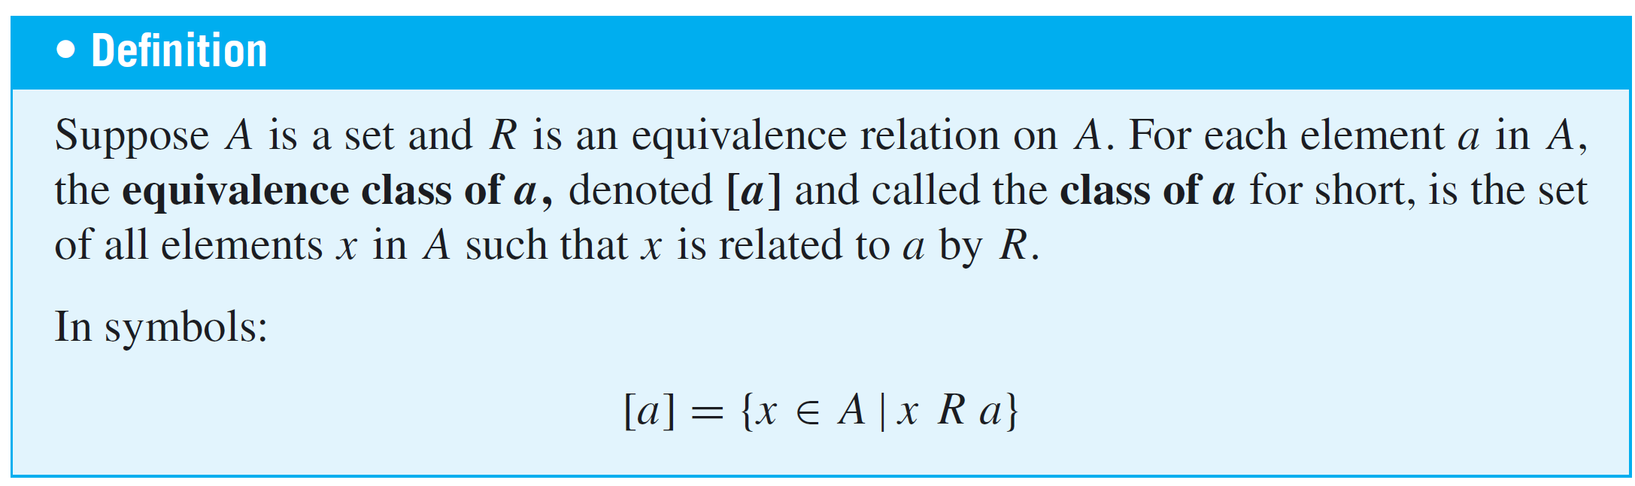
Example 3 – Solution
cont’d
Hence
By the notation of equivalence classes, ∗-equivalence classes of states of A are denoted as

Slide 32
The Quotient Automaton

Slide 33
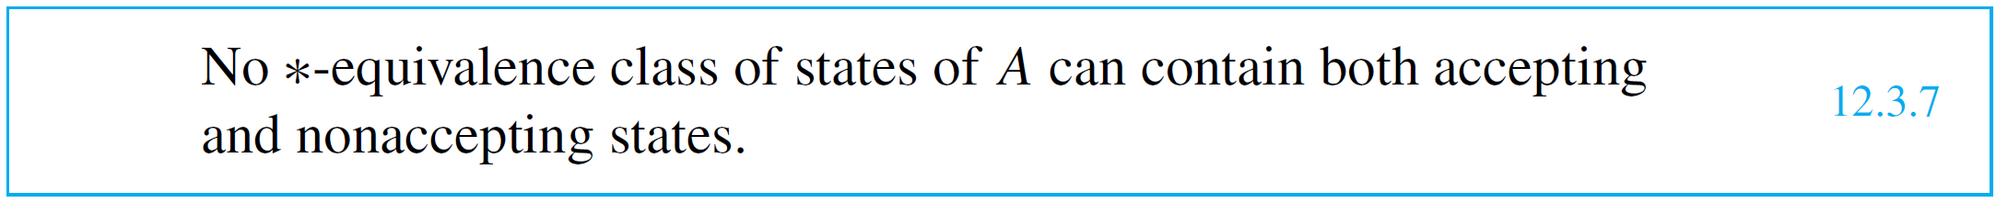

The Quotient Automaton
We next define the quotient automaton A of an automaton A. However, in order for all parts of the definition to make sense, we must point out two facts.
The reason this is true is that the 0-equivalence classes divide the set of states of A into accepting and nonaccepting states, and the ∗-equivalence classes are subsets of 0-equivalence classes.

Slide 34
The Quotient Automaton
This is true for the following reason. Suppose states s and t are ∗-equivalent. Then any input string that sends A to an accepting state when A is in state s sends A to an accepting state when A is in state t.
Now suppose m is any input symbol, and consider the
next-states N(s, m) and N(t, m).
Inputting a string of length k to A when A is in state N(s, m) or N(t, m) produces the same effect as inputting a certain string of length k + 1 to A when A is in state s or t (namely the concatenation of m with the string of length k).

Slide 35
The Quotient Automaton
Hence any string that sends A to an accepting state when A is in state N(s, m) also sends A to an accepting state when A is in state N(t, m).
It follows that N(s, m) and N(t, m) are ∗-equivalent.
Now we can define the quotient automaton A of A.

Slide 36
The Quotient Automaton
It is the finite-state automaton whose states are the ∗-equivalence classes of states of A, whose initial state is the ∗-equivalence class containing the initial state of A, whose accepting states are of the form [s] where s is an accepting state of A, whose input symbols are the same as the input symbols of A, and whose next-state function is derived from the next-state function for A in the following way:
To find the next-state of A for a state s and an input symbol m, pick any state t in [s] and look to see what
next-state A goes to if m is input when A is in state t; the equivalence class of this state is the next-state of A.

Slide 37
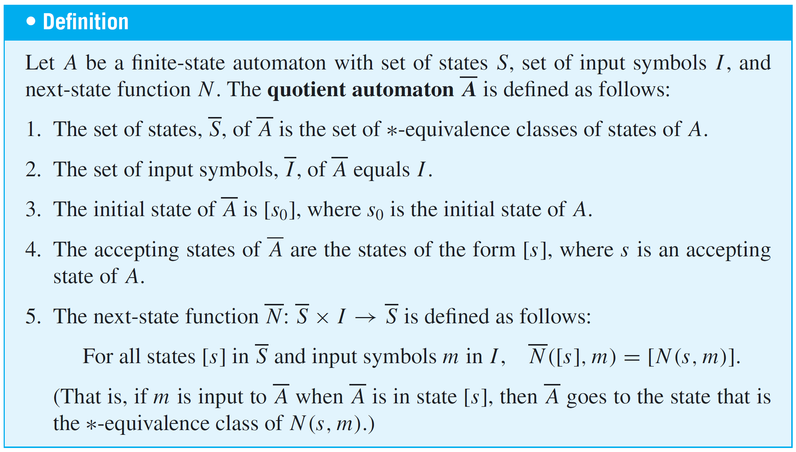
The Quotient Automaton

Slide 38
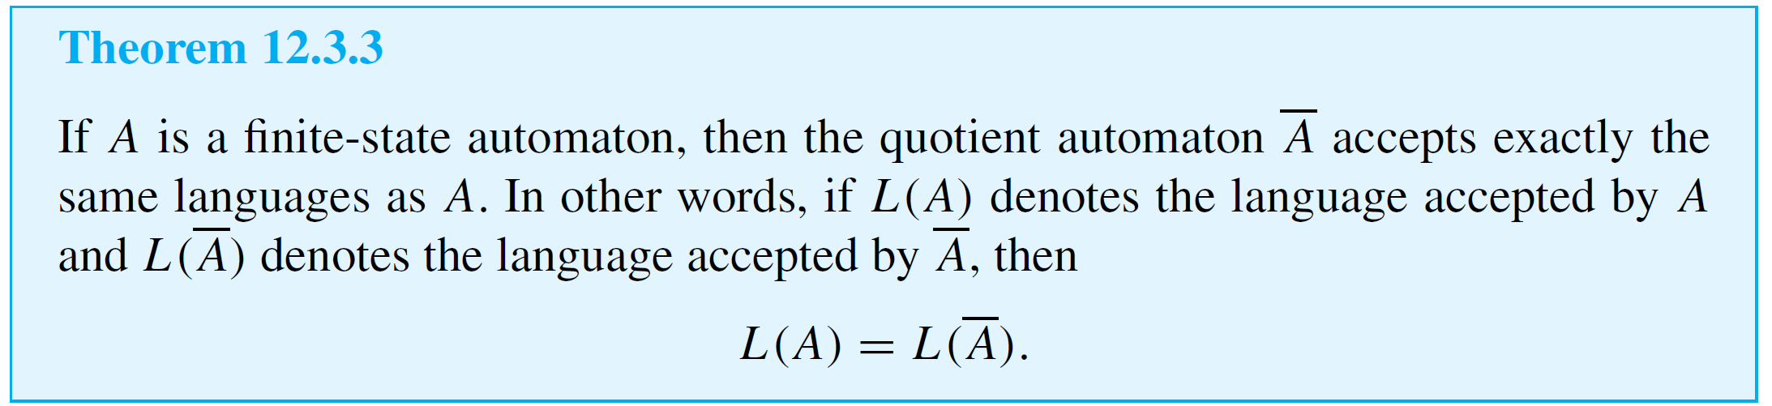
The Quotient Automaton
Note that since the states of A are sets of states of A, A generally has fewer states than A. (A and A have the same number of states only in the case where each ∗-equivalence class of states contains just one element.)
Also, by property (12.3.7), each accepting state of A consists entirely of accepting states of A. Furthermore, property (12.3.8) guarantees that the next-state function N is well defined.

Slide 39
Constructing the Quotient Automaton

Slide 40
Constructing the Quotient Automaton
Let A be a finite-state automaton with set of states S,
next-state function N, relation R∗ of ∗-equivalence of states, and relation R_{k} of k-equivalence of states.
It follows from Theorems 12.3.2 and 12.3.3 and from the definition of quotient automaton that to find the quotient automaton A of A, you can proceed as follows:
1. Find the set of 0-equivalence classes of S.

Slide 41
Constructing the Quotient Automaton
2. For each integer k ≥ 1, subdivide the (k − 1)-equivalence classes of S (as described earlier) to find the k-equivalence classes of S.
Stop subdividing when you observe that for some integer K the set of (K + 1)-equivalence classes equals the set of K-equivalence classes.
At this point, conclude that the set of K-equivalence classes equals the set of ∗-equivalence classes.

Slide 42
Constructing the Quotient Automaton
3. Construct the quotient automaton A whose states are the ∗-equivalence classes of states of A and whose
next-state function N is given by
where s is any state in [s]. [That is, to see where A goes if m is input to A when it is in state s, look to see where A goes if m is input to A when it is in state s. The ∗-equivalence class of that state is the answer.]

Slide 43
Example 4 – Constructing a Quotient Automaton
Consider the automaton A of Examples 2 and 3. This automaton is shown again below for reference. Find the quotient automaton of A.

Slide 44
Example 4 – Solution
According to Example 3 the ∗-equivalence classes of the states of A are
Hence the states of the quotient automaton A are
The accepting states of A are s₂ and s₃, so the accepting state of A is [s₂] = [s₃].

Slide 45
Example 4 – Solution
cont’d
The next-state function N of A is defined as follows: for all states [s] and input symbols m of A,
Thus,
But N(s₀, 0) = s₀, so

Slide 46
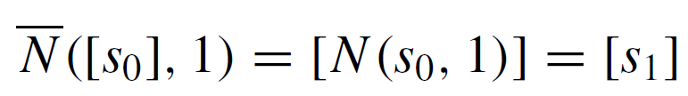

Example 4 – Solution
cont’d
Similarly,

Slide 47
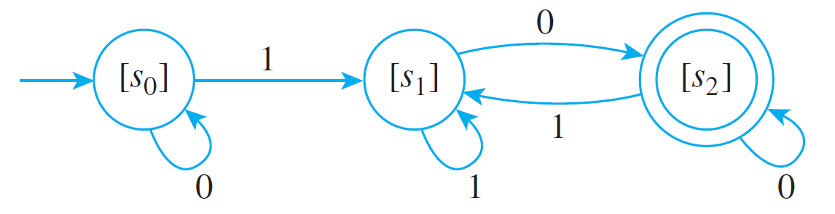
Example 4 – Solution
cont’d
The transition diagram for A is, therefore, as shown below.
By Theorem 12.3.3, this automaton accepts the same language as the original automaton.

Slide 48
Equivalent Automata

Slide 49
Equivalent Automata
Output devices may be attached to the states of finite-state automata to indicate whether they are accepting or nonaccepting states.
For example, accepting states might produce an output of 1 and nonaccepting states an output of 0.
Then a finite-state automaton can be thought of as an input/output device whose input consists of strings and whose output consists of 0’s and 1’s.

Slide 50
Equivalent Automata
We know that a circuit can be thought of as a black box that transforms combinations of input signals into output signals.
Two circuits that produce identical output signals for each combination of input signals are called equivalent.
Similarly, a finite-state automaton can be regarded as a black box that processes input strings and produces output signals (indicating whether or not the strings are accepted).

Slide 51
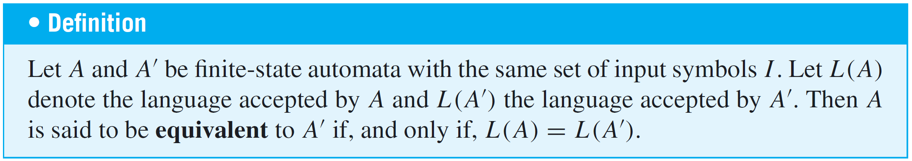
Equivalent Automata
Two finite-state automata are called equivalent if they produce identical output signals for each input string.
But this means that two finite-state automata are equivalent if, and only if, they accept the same language.

Slide 52
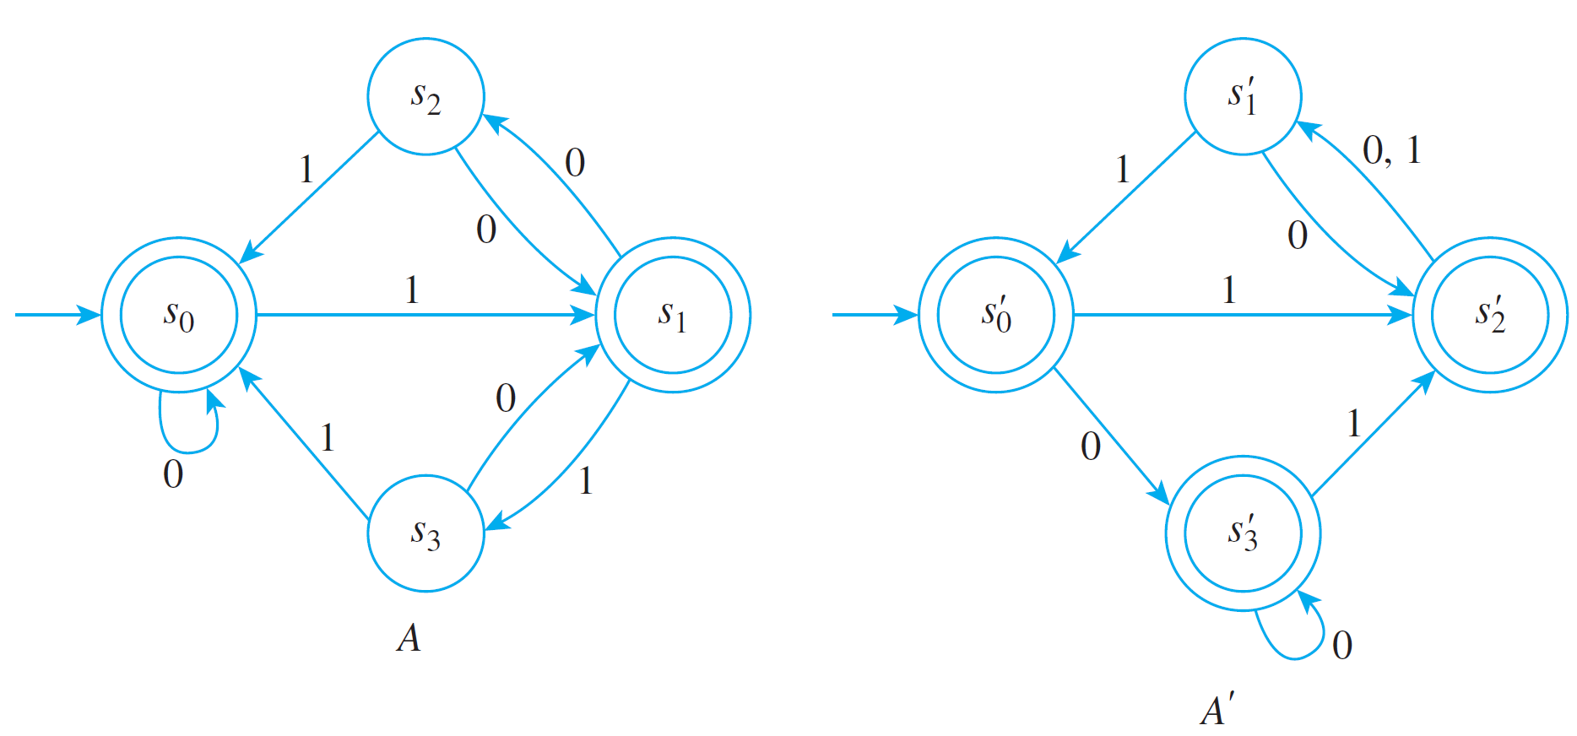
Example 5 – Showing That Two Automata Are Equivalent
Show that the automata A and A′ that follow are equivalent.
The label 0, 1 on an arrow of a transition diagram means that for either input 0 or 1, the next-state of the automaton is the state to which the arrow points.

Slide 53
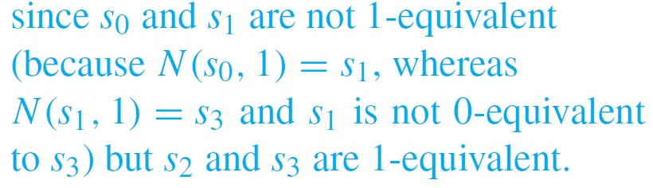
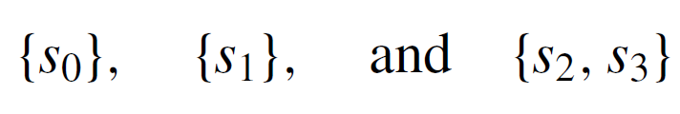
Example 5 – Solution
For the automaton A: The 0-equivalence classes are
The 1-equivalence classes are
The 2-equivalence classes are

Slide 54

Example 5 – Solution
cont’d
This discussion shows that the set of 1-equivalence classes equals the set of 2-equivalence classes, so by Theorem 12.3.2 this is equal to the set of ∗-equivalence classes.
Hence the ∗-equivalence classes are
For the automaton A′ : By reasoning similar to that done previously, the 0-equivalence classes are

Slide 55
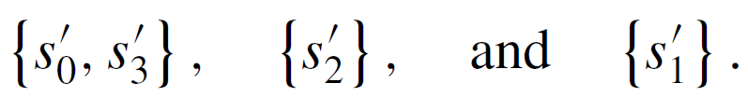
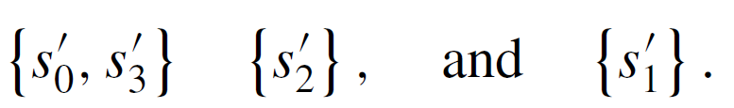
Example 5 – Solution
cont’d
The 1-equivalence classes are
The 2-equivalence classes are the same as the 1- equivalence classes, which are therefore equal to the ∗-equivalence classes.
Thus the ∗-equivalence classes are

Slide 56
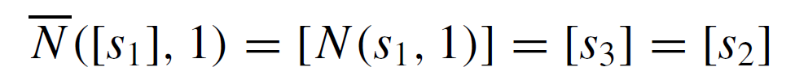
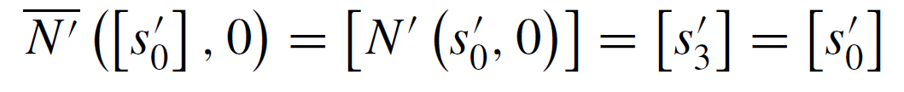
Example 5 – Solution
cont’d
To calculate the next-state functions for A and A′, you repeatedly use the fact that in the quotient automaton, the next-state of [s] and m is the class of the next-state of s and m.
For instance,
and
where N is the next-state function for A and N′ is the
next-state function for A′.

Slide 57
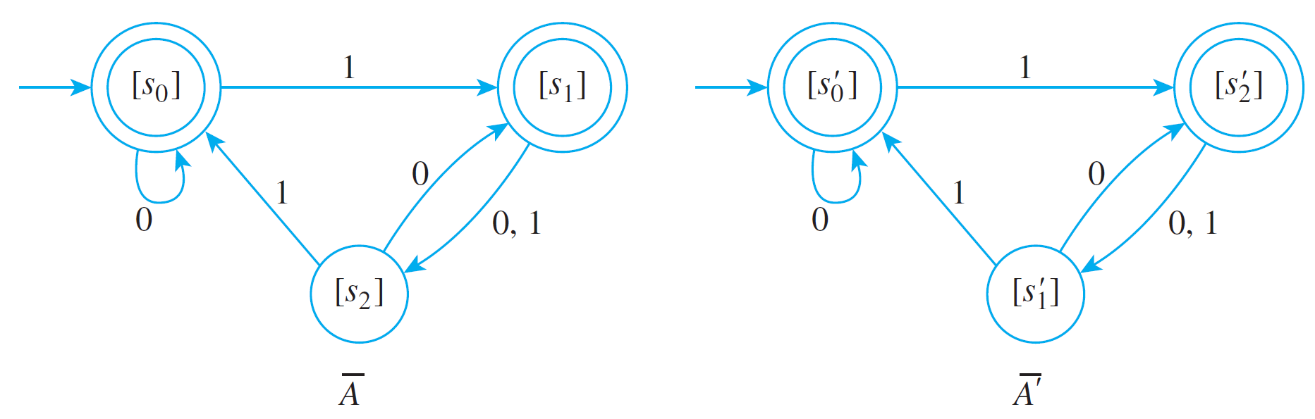
Example 5 – Solution
cont’d
The complete transition diagrams for the quotient automata A and A′ are shown below.

Slide 58
Example 5 – Solution
cont’d
As you can see, except for the labeling of the names of the states, A and A′ are identical and hence accept the same language.
But by Theorem 12.3.3, each original automaton accepts the same language as its quotient automaton.
Thus A and A′ accept the same language, and so they are equivalent.

Slide 59
Equivalent Automata
In mathematics an object such as a finite-state automaton is called a structure.
In general, when two mathematical structures are the same in all respects except for the labeling given to their elements, they are called isomorphic, which comes from the Greek words isos, meaning “same” or “equal,” and morphe, meaning “from.”

Slide 60
Equivalent Automata
It can be shown that two automata are equivalent if, and only if, their quotient automata are isomorphic, provided that “inaccessible states” have first been removed.
(Inaccessible states are those that cannot be reached by inputting any string of symbols to the automaton when it is in its initial state.)

